Slide 1
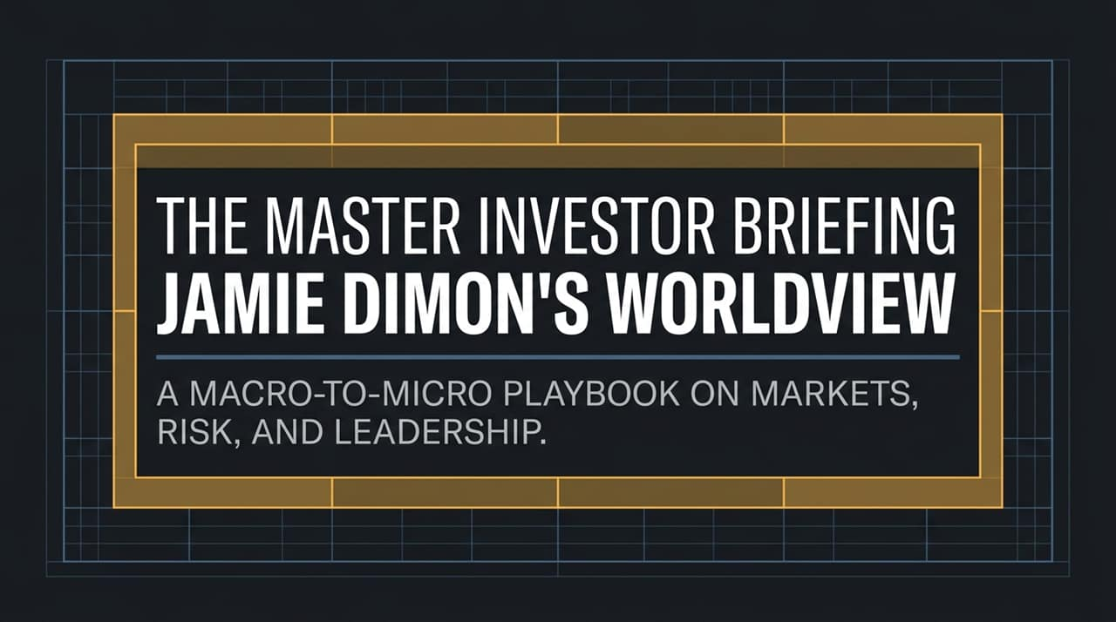
Notes:
https://www.youtube.com/watch?v=vNbY8kR6-j0
Welcome, everyone. Today we are walking through the strategic worldview and leadership philosophy of Jamie Dimon, Chairman and CEO of JPMorgan Chase.
Over a 20-year tenure that navigated the 2008 Financial Crisis, the European sovereign debt crisis, the pandemic, and recent regional banking turmoil, Dimon has developed a distinct operational framework—what we call The Dimon Doctrine.
This briefing synthesizes macro market conditions, sovereign debt warnings, anti-bureaucracy management tactics, and core leadership principles into a single, cohesive playbook.

Slide 2
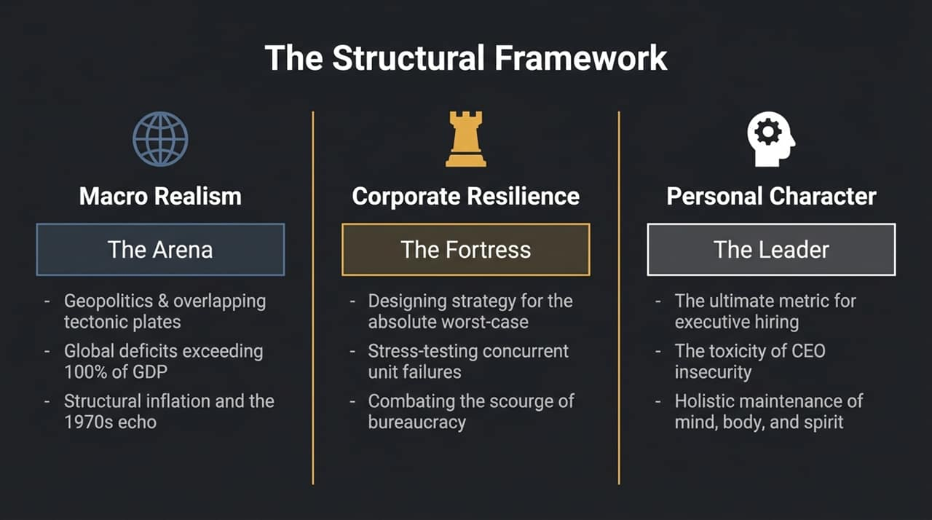
Notes:
To understand Dimon’s approach, we break his strategy down into three distinct pillars:
1. Macro Realism (The Arena): We must assess global markets without wishful thinking. This involves tracking geopolitical 'tectonic plates,' massive global debt deficits exceeding 100% of GDP, and persistent structural inflation.
2. Corporate Resilience (The Fortress): Success requires designing strategies for absolute worst-case scenarios. We stress-test concurrent unit failures and aggressively eliminate bureaucratic complacency.
3. Personal Character (The Leader): Character is the ultimate metric when hiring or promoting executives. We must combat CEO insecurity and maintain holistic discipline across mind, body, and spirit.

Slide 3
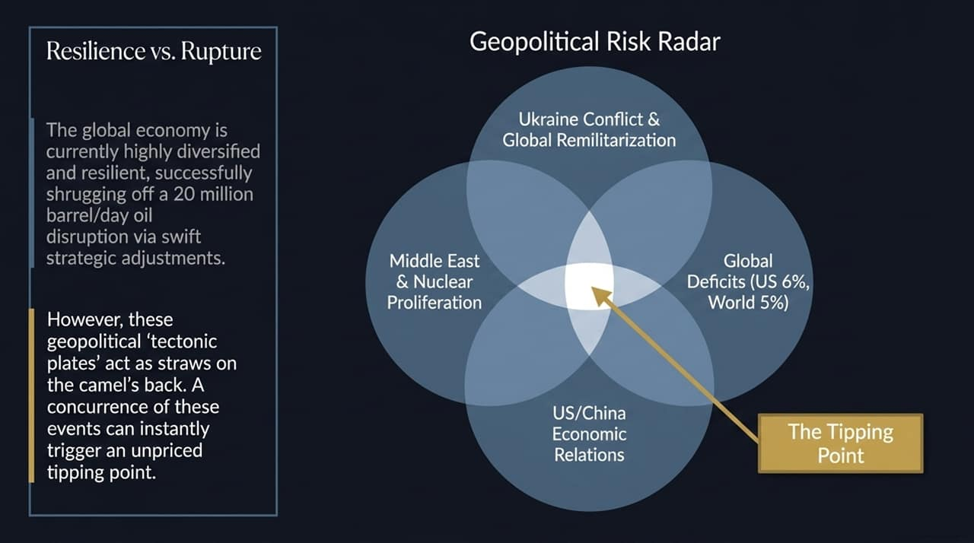
Notes:
Looking at the current macroeconomic backdrop, we see a duality between market resilience and systemic fragility.
On one hand, global markets have proven surprisingly resilient—swiftly adjusting even to severe disruptions, such as shrugging off a 20-million-barrel-per-day oil shock through re-routed supply chains and drawdowns.
However, Dimon warns against complacency. Overlapping risks—including the war in Ukraine, Middle East instability, US-China economic tension, and global deficits (with the US debt deficit at 6% of GDP and world deficits near 5%)—act like tectonic plates shifting simultaneously.
A concurrence of these factors can trigger an unpriced tipping point where markets suddenly reprice risk overnight.

Slide 4
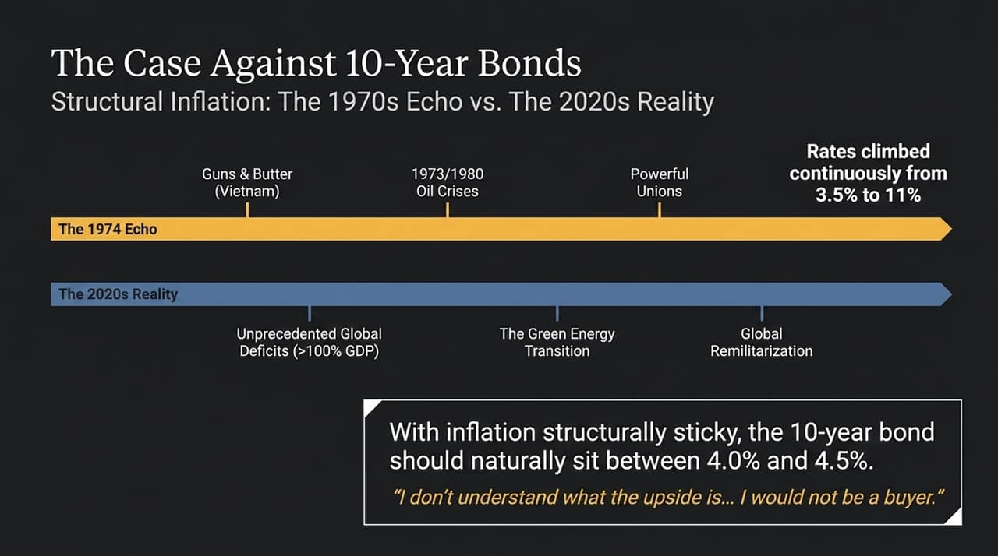
Notes:
When asked directly about fixed income, Dimon's position is clear: he would not be a buyer of long-dated government bonds.
Drawing a historical parallel to 1974, after the Vietnam war and oil shocks, inflation climbed persistently and forced yields up from 3.5% to 11%.
Today's drivers—unprecedented global deficits (>100% debt-to-GDP), green energy transition costs, and global remilitarization—create sticky structural inflation.
Even with target inflation around 2%, fair yield on a 10-year Treasury should naturally sit around 4.0% to 4.5%. With yields already near those levels, there is very little upside compensation for holding long-term interest rate risk.

Slide 5
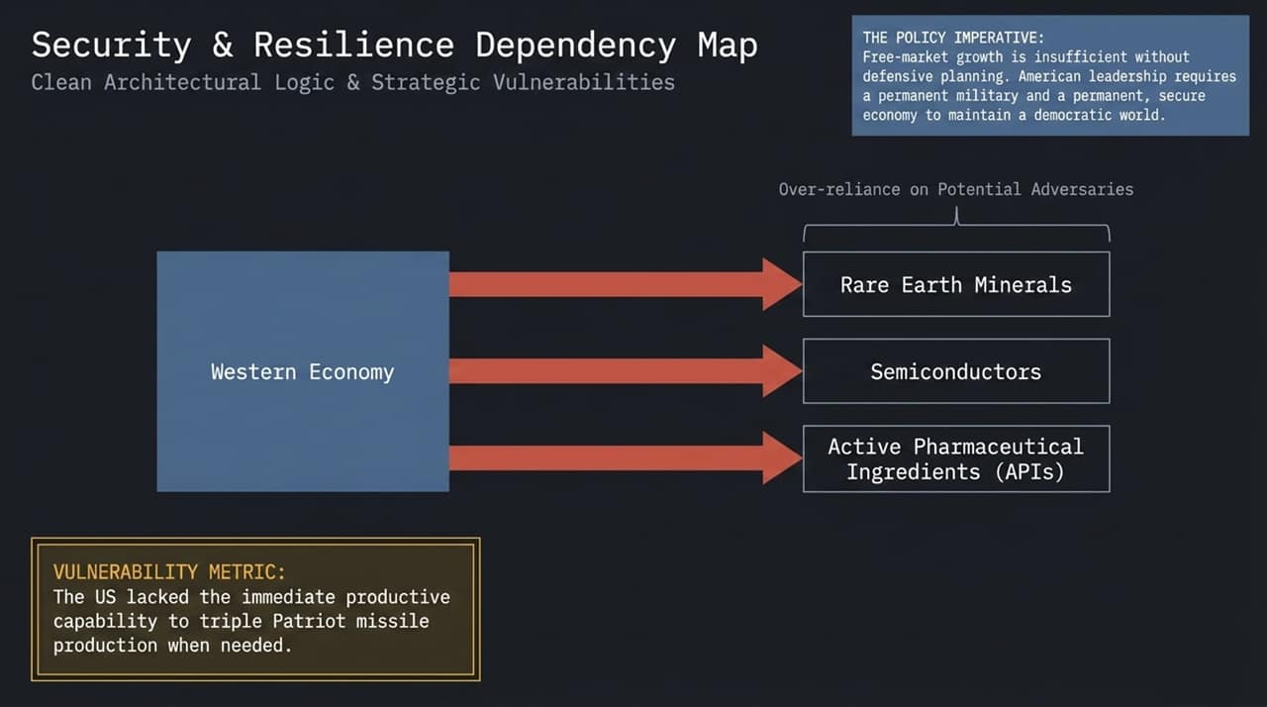
Notes:
"Summarizing the macro side:
Government Deficits: Debt-to-GDP at 100% globally and a 6% US budget deficit represent a looming structural threat. If unresolved through deliberate policy, market forces like 'bond vigilantes' will force the issue via higher rates.
AI Frontier: Dimon compares AI to the rise of the internet. It is a real, transformative technology that will revolutionize healthcare, code writing, and efficiency.
However, payback periods won't follow linear market expectations. Much like early internet hype where many companies collapsed before tech giants emerged, corporate spending on AI will face a period of rigorous ROI discipline."

Slide 6
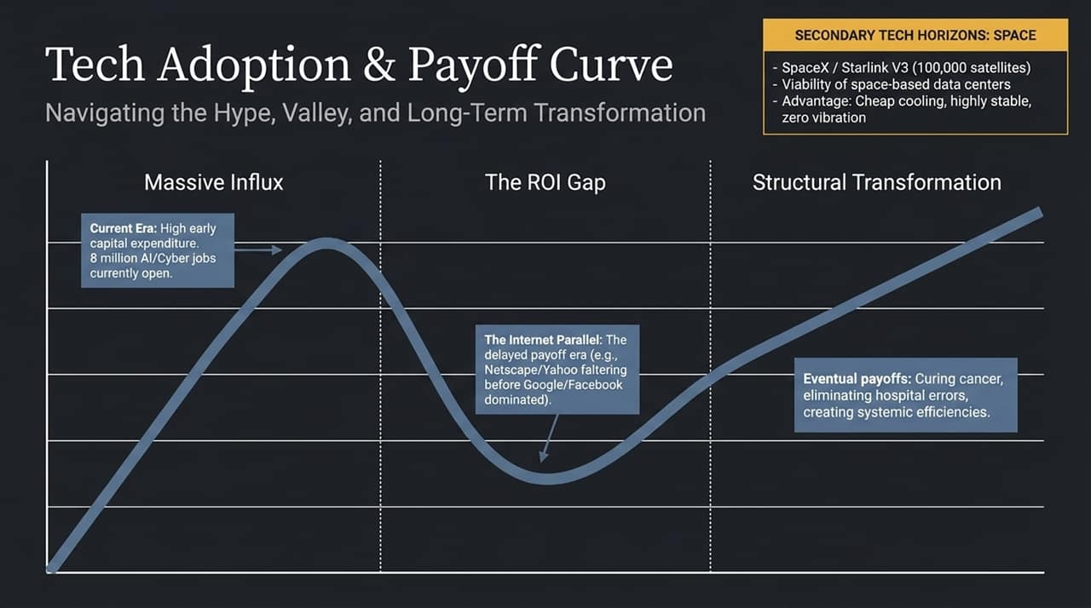
Notes:
To appreciate the execution behind this playbook, look at JPMorgan Chase’s trajectory since 2006:
US Market Rank: Moved from 3rd or 4th position to the #1 largest bank in the US.
Market Capitalization: Expanded eightfold from ~$112 Billion to ~$900 Billion.
Headcount: Scaled operations from ~150,000 to ~320,000 employees globally.
This growth was not driven by aiming to 'be the biggest,' but by maintaining operational excellence, stress-testing worst cases, and compounding advantages through every downturn."

Slide 7
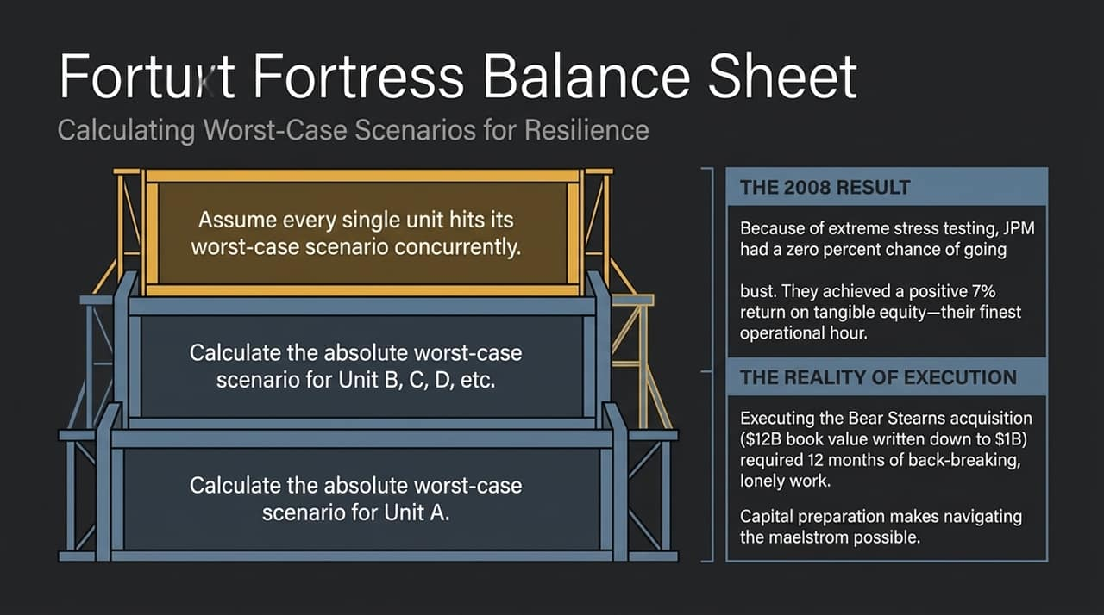
Notes:
How does a bank maintain a 0% chance of going bust during a generational panic? Through the 'Fortress' mindset.
Dimon's risk model doesn't just stress-test individual business units; it assumes every single unit fails simultaneously. If the firm can survive that compounding worst-case scenario, it can handle real-world shocks.
However, executing this strategy requires immense intestinal fortitude.
Reflecting on crisis-era acquisitions (like Bear Stearns), Dimon noted that after all due diligence is complete and the board votes, signing the final document commits tens of thousands of employees to months of backbreaking, stressful work. Holding that responsibility creates a 'pit in your stomach'—and that final call is ultimately lonely.

Slide 8
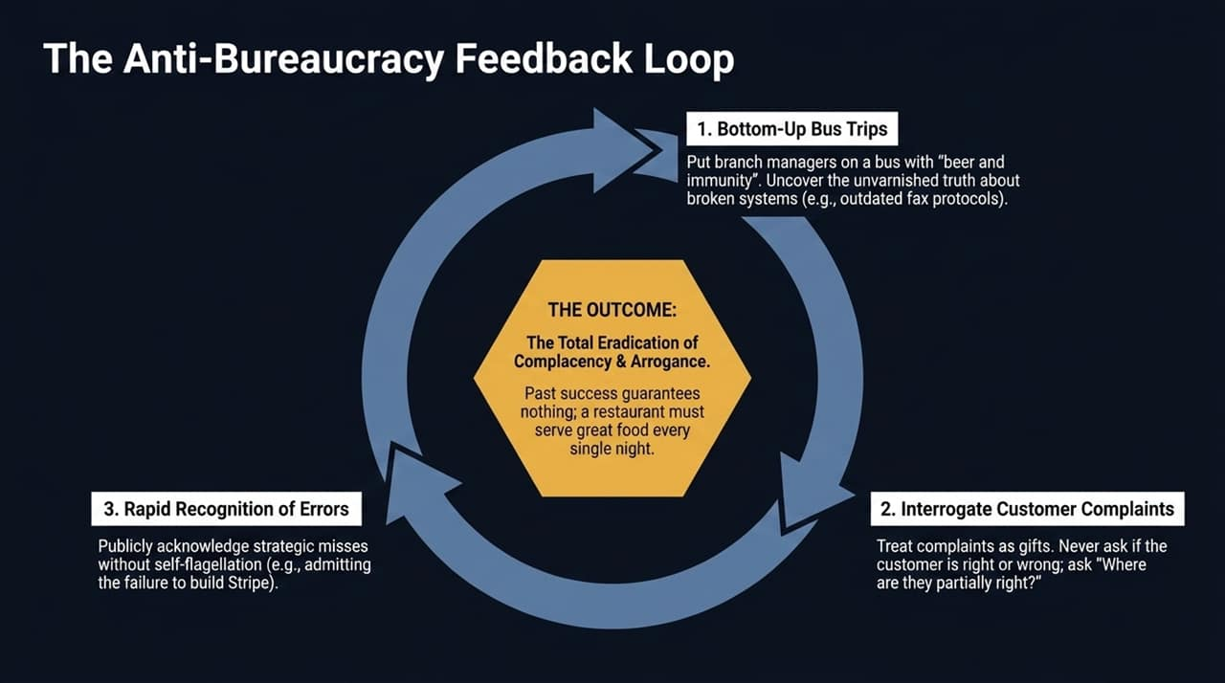
Notes:
As organizations scale, bureaucracy, arrogance, and complacency naturally creep in. Dimon breaks this cycle using a 3-step feedback loop:
1. Bottom-Up Bus Trips: Put frontline branch managers and tellers on a bus with 'beer and immunity'. Uncover broken operational protocols (like outdated fax requirements) directly from those doing the work.
2. Interrogate Customer Complaints: Treat complaints as valuable gifts. Don't ask if the customer is 100% right; ask 'Where are they partially right?'
3. Rapid Recognition of Errors: Publicly acknowledge strategic misses (e.g., missing the initial opportunity around Stripe) without defensiveness.
The Outcome: The total eradication of complacency. Past success guarantees nothing; a company must operate like a top restaurant, delivering flawless execution every single night.

Slide 9
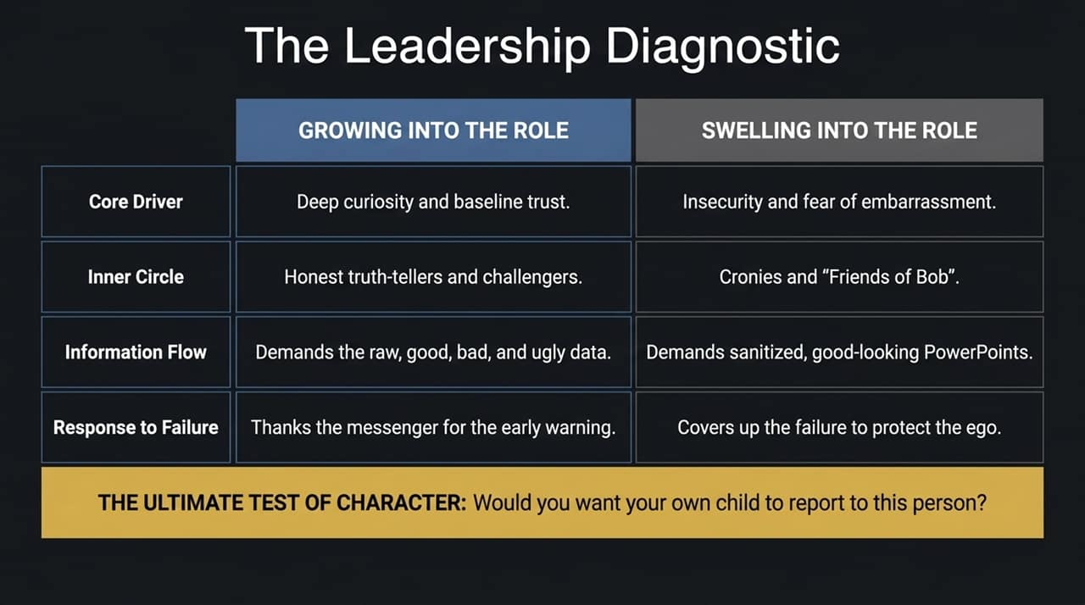
Notes:
When hiring and promoting leaders, Dimon revives J.P. Morgan Sr.'s foundational motto: 'Above all else is character.'
A practical stress-test for executive hiring: 'Would you want your own child reporting to this leader?' If the answer is no, they shouldn't be promoted, regardless of their revenue generation.
The Toxicity of CEO Insecurity: When leaders get promoted beyond their core expertise, insecurity can set in. Insecure leaders surround themselves with sycophants, filter out bad news, and rely on polished PowerPoint slides rather than ground truth. Secure leaders foster trust, encourage debate, and aren't afraid to admit what they don't know.

Slide 10
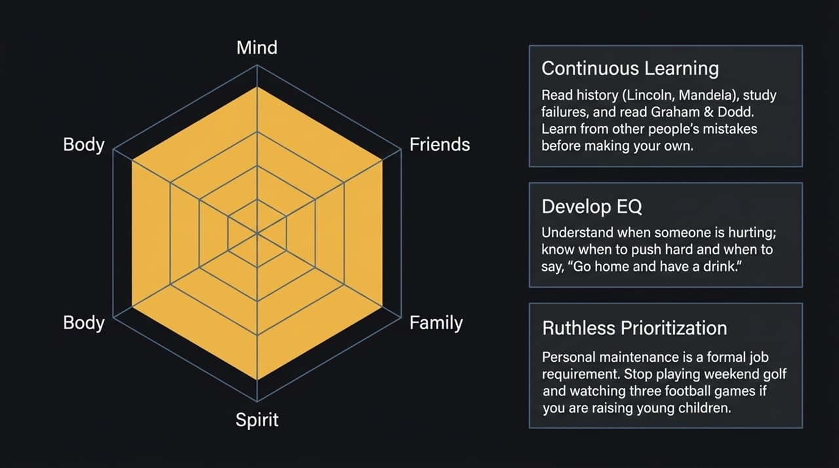
Notes:
Sustained high performance requires deliberate maintenance across four areas:
Continuous Learning: Read broadly across political spectrums and study history. History teaches us how people behave under pressure and lets us learn from others' mistakes rather than making them ourselves.
Communication & EQ: Develop empathy, practice active listening, and structure clear communication.
Personal Discipline & Boundaries: High-demand roles require extreme calendar discipline. Eliminate low-value distractions to safeguard time for health, soul, and family.

Slide 11
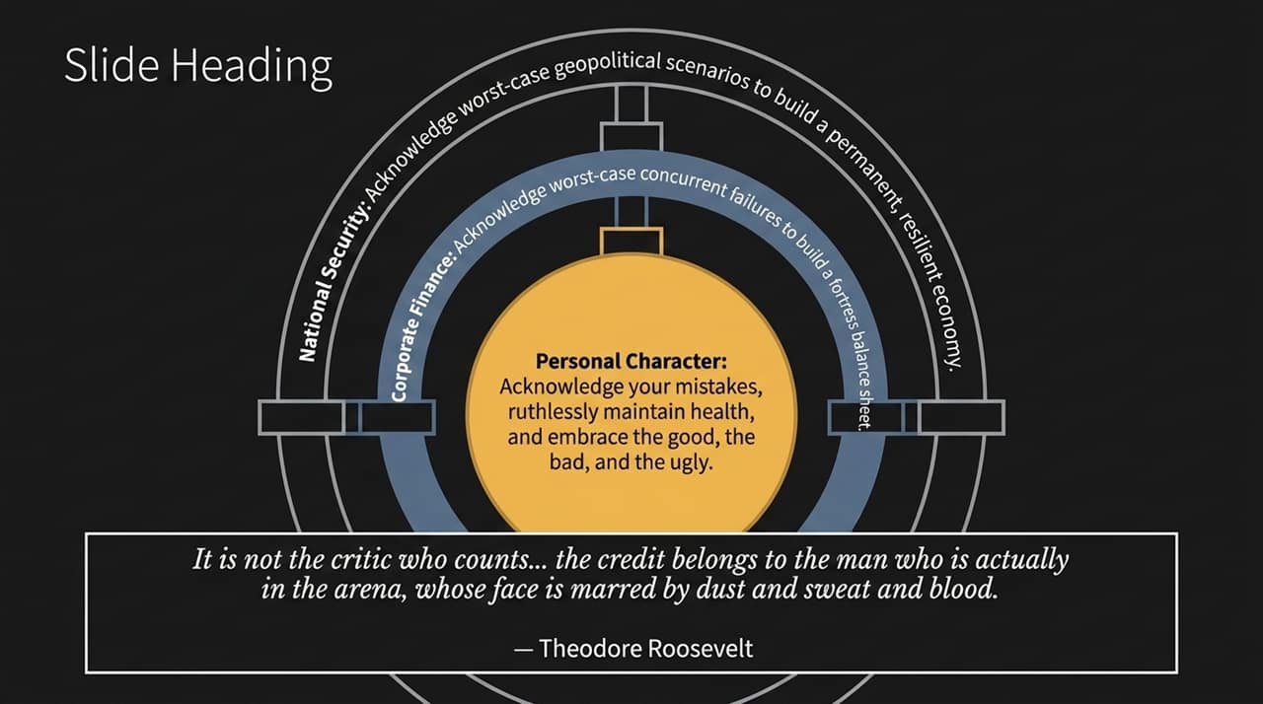
Notes:
This slide brings together the entire framework into a single reference blueprint:
Macro & Market Frontier: Avoid long-dated bonds due to sticky structural inflation; treat 100% debt-to-GDP and 6% deficits as unpriced market tail risks; and view AI as a net-positive technology with non-linear payoff timelines.
Leadership & Organization: Hire exclusively for character; battle bureaucracy by inviting unvarnished ground truth; embrace rapid error recognition; and build 'fortress' balance sheets capable of withstanding severe, simultaneous unit shocks.

Slide 12
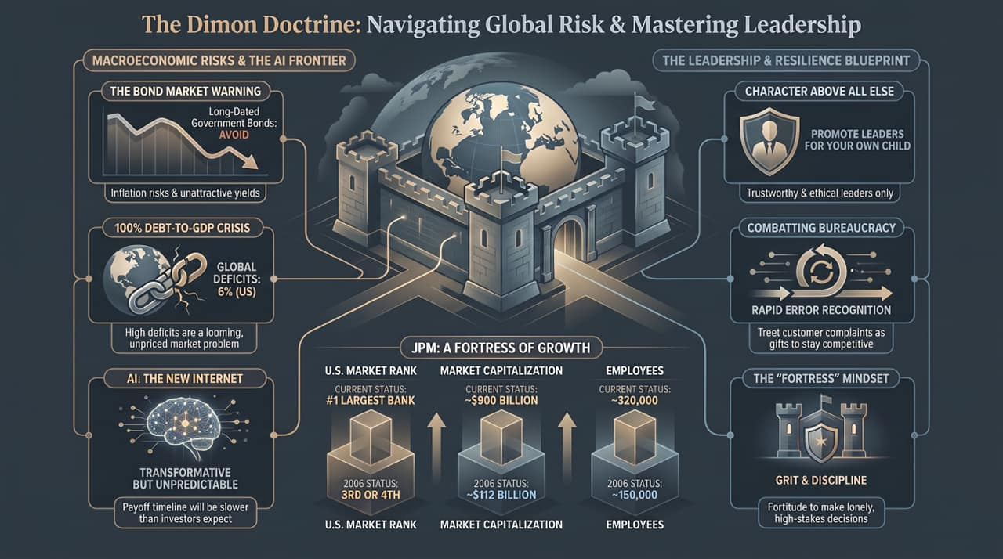
Notes:
To wrap up today's briefing: The Dimon Doctrine is ultimately about balancing realism with relentless execution.
We cannot control macroeconomic shocks, geopolitical shifts, or market cycles. What we can control is how we build our organizations—ensuring they are fortress-ready, free of bureaucratic arrogance, led by people of high character, and committed to long-term value creation.
Thank you for your time, and I am now happy to open the floor for any questions.

